Slide 1
Results Discussion: Right-Handed Pitchers
Thomas van Hogerwou

Slide 2
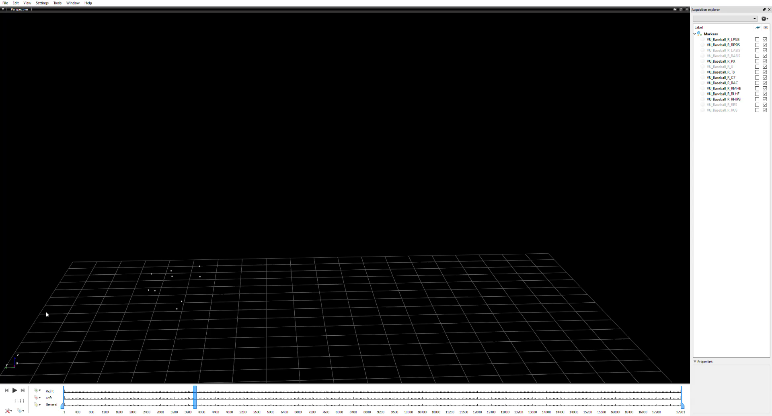
Raw marker data

Slide 3
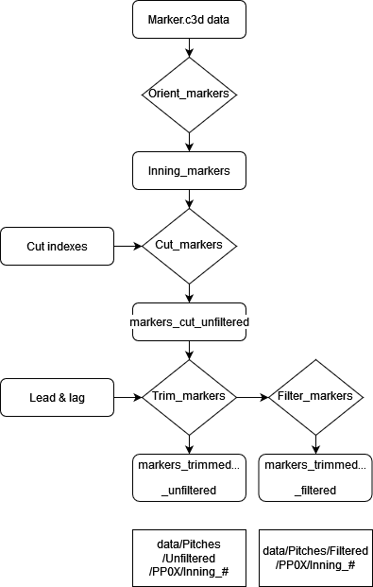
Preprocessing_cut_filter.py

Slide 4
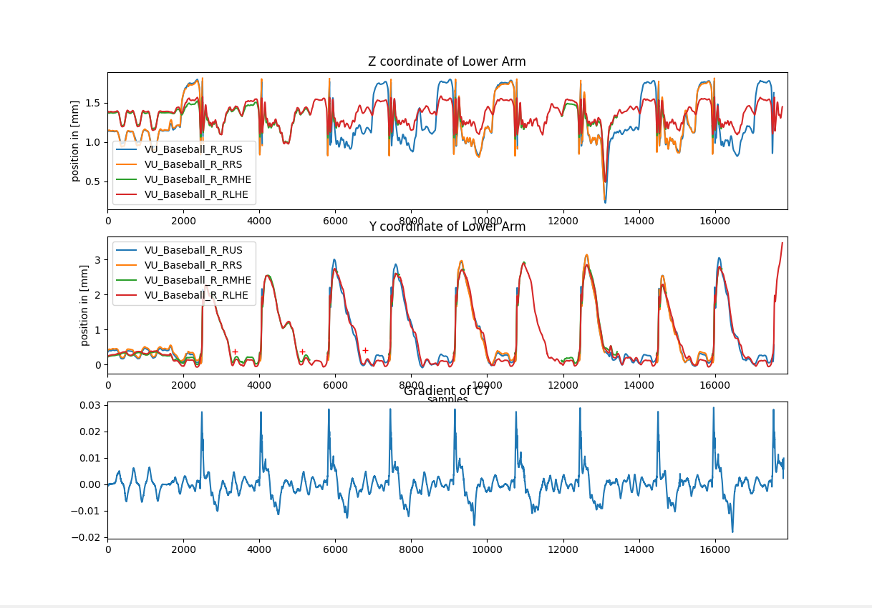
Preprocessing_cut_filter.py

Slide 5
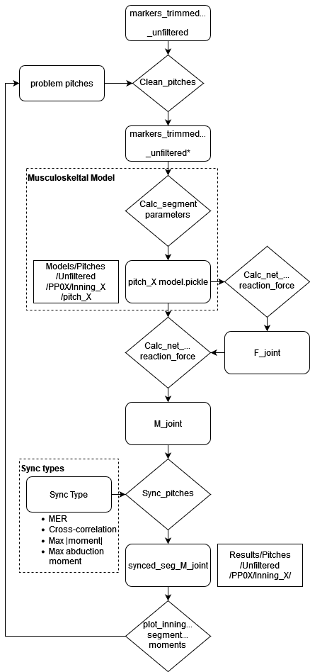
Main_PP0X.py

Slide 6
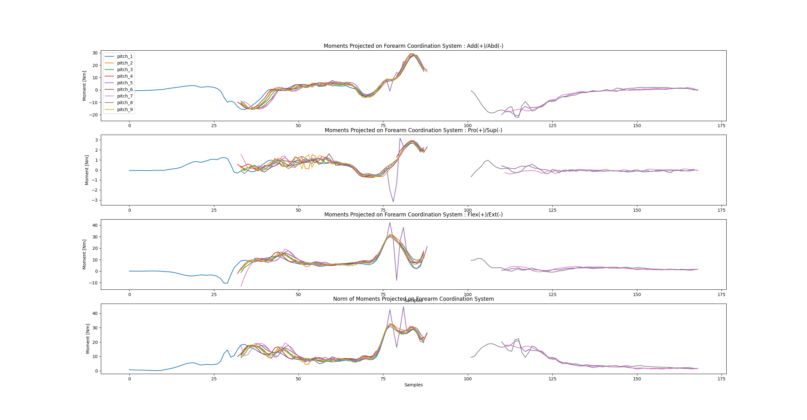
Plot_inning_segment_moments

Slide 7
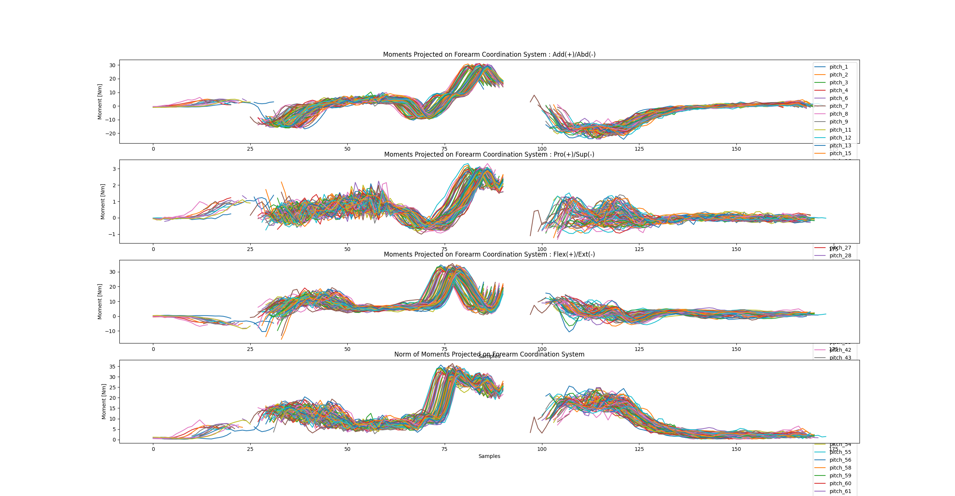
Find peak adduction / abduction moments

Slide 8
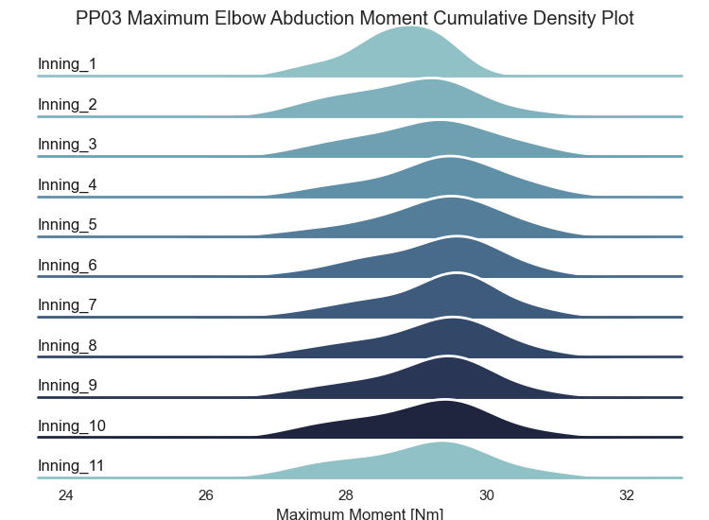
Cumulative Innings

Slide 9
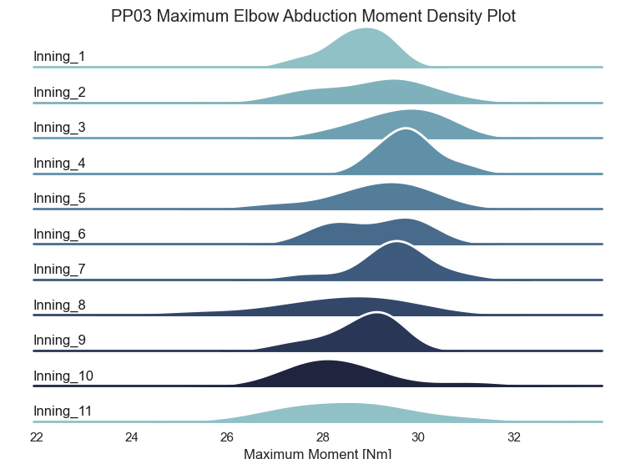
Per Inning

Slide 10
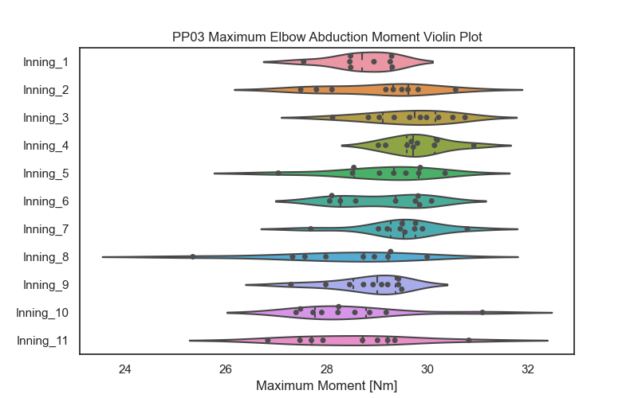
Per Inning

Slide 11
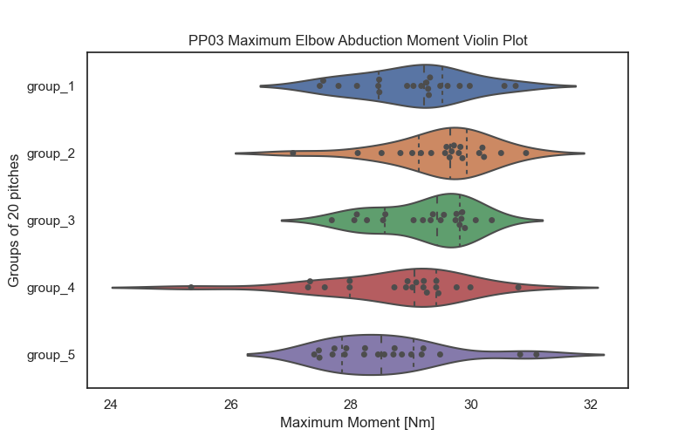
Groups of N pitches

Slide 12
Preliminary observations
An “Inning” of 10 pitches does not show a normal distribution but scaling to ~20/25 pitches per “Group” does.
Outliers on the lower side of the distribution are often caused by losing sight of markers before MER.
Between group_1 and group_2 a small increase in mean is often observed
1,3,4,5,6,8,12,14
Notes:
1, 2, 5, 14 are problem pitchers. Many removed pitches dirty the results

Slide 13
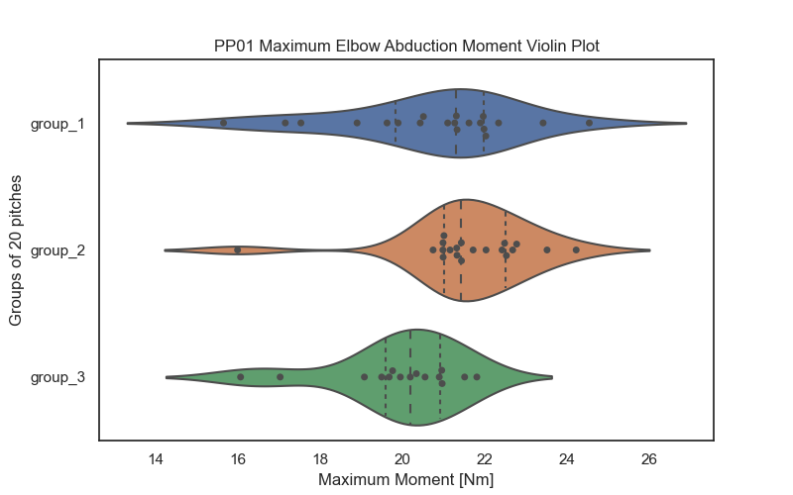
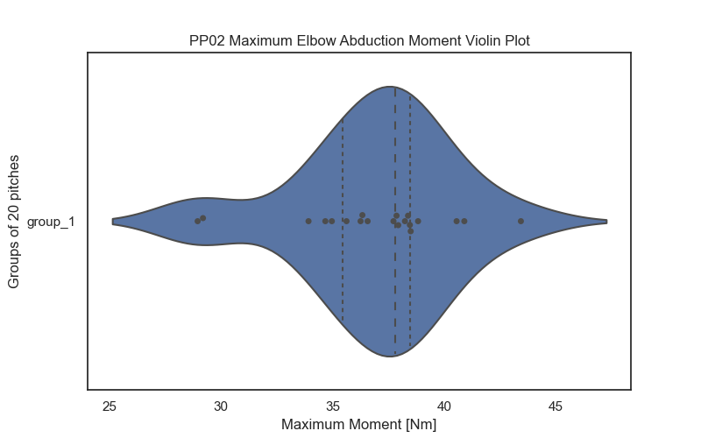
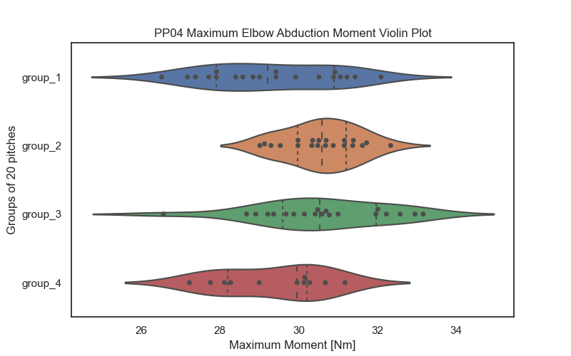
Group_1 → Group_2 increase
PP01 & PP02 contain many invalid pitches due to marker issue

Slide 14
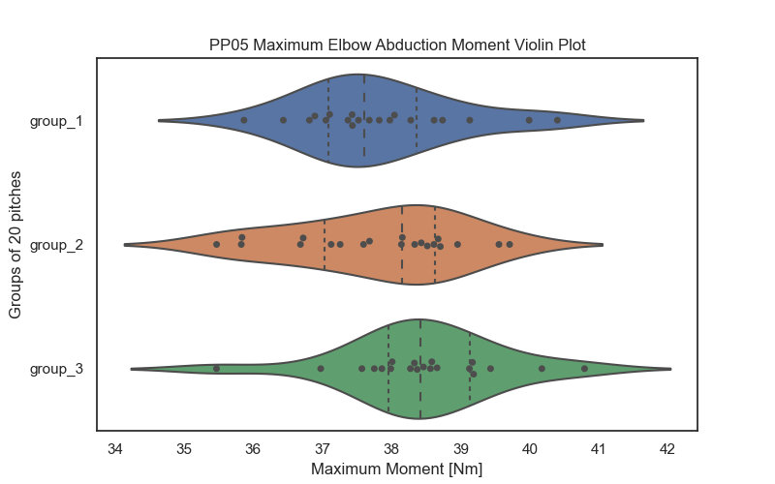
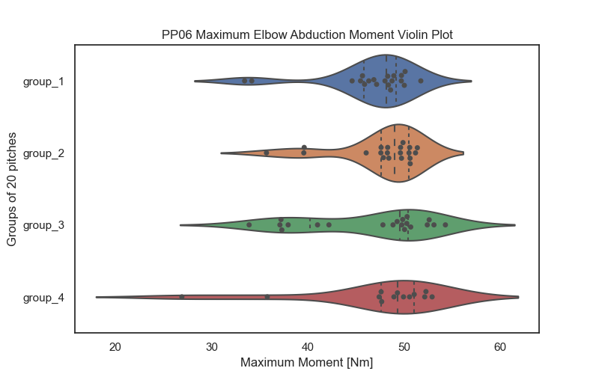
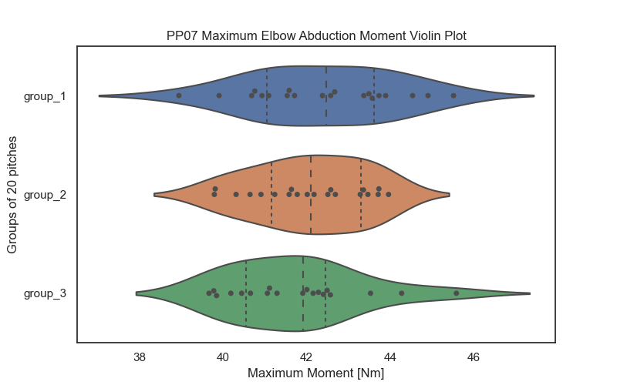
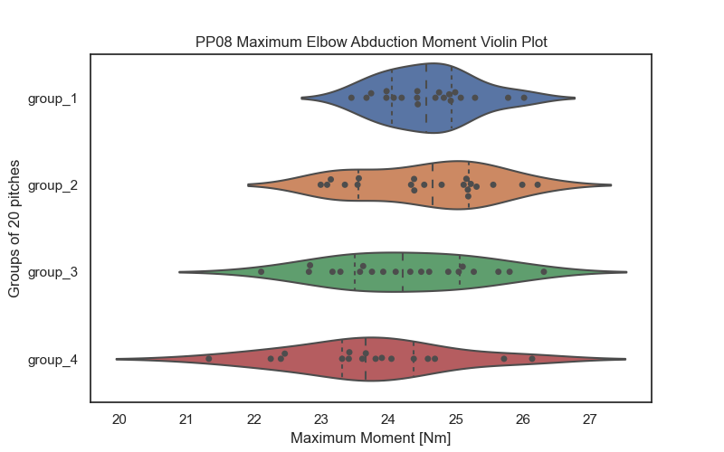
Group_1 → Group_2 increase
PP05 has ~20 invalid pitches after 80 valid, thus no group_4

Slide 15
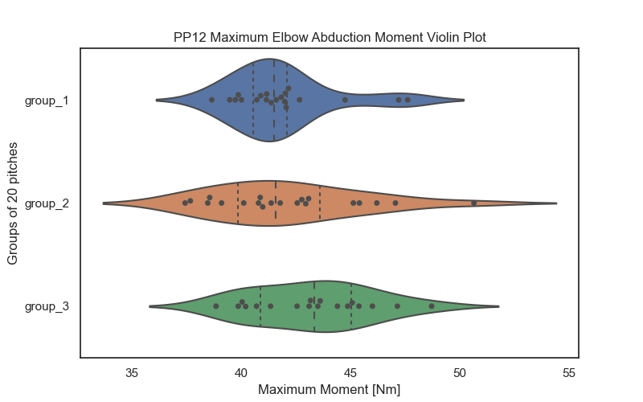
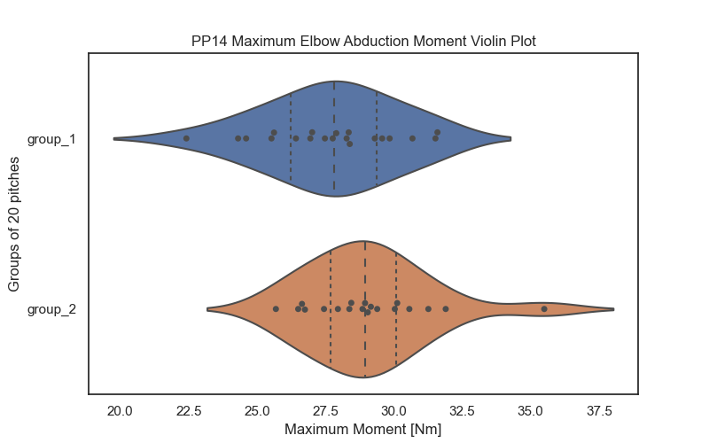
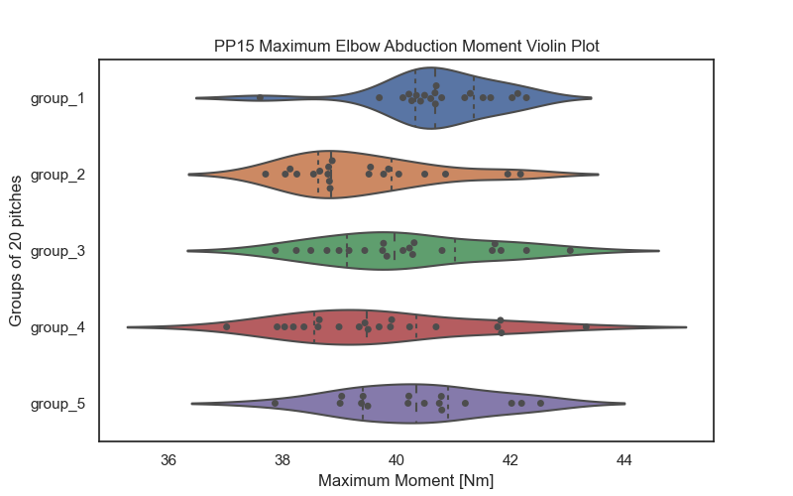
Group_1 → Group_2 increase
Up till pitch 40 I only have 4 valid pitches

Slide 16
What’s next?
Left-handed pitchers
Normalize for ball speed
Moving coefficient of variance
Integrate fatigue self report data
Integrate sEMG data

